Slide 1
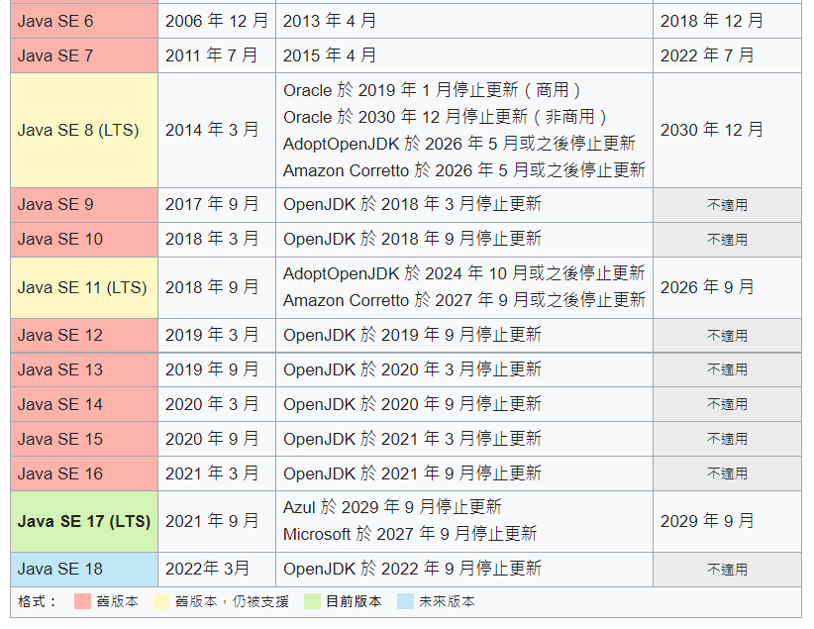
Java版本

Slide 2
使用到的技術
Spring Boot 版本:2.6.6
Mysql:8.0.27
單元測試:H2 DataBase JUnite5
Dao層使用Spring JDBC

Slide 3
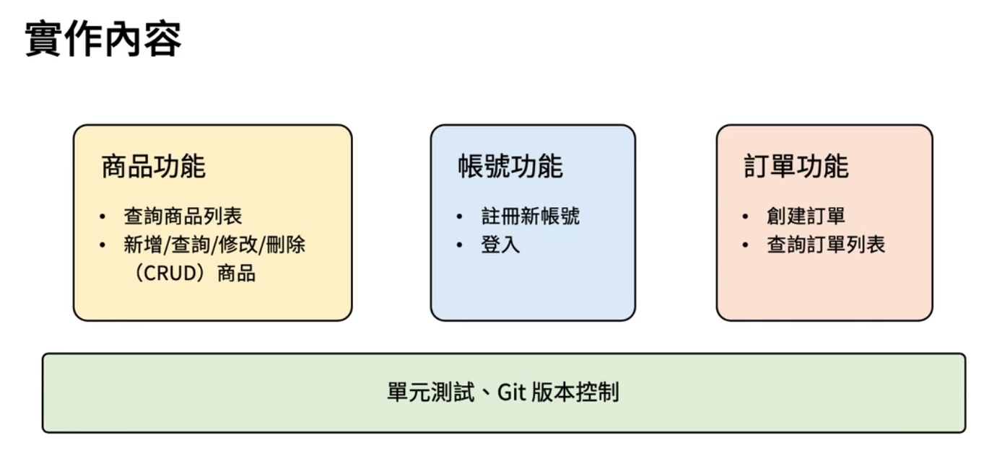

Slide 4
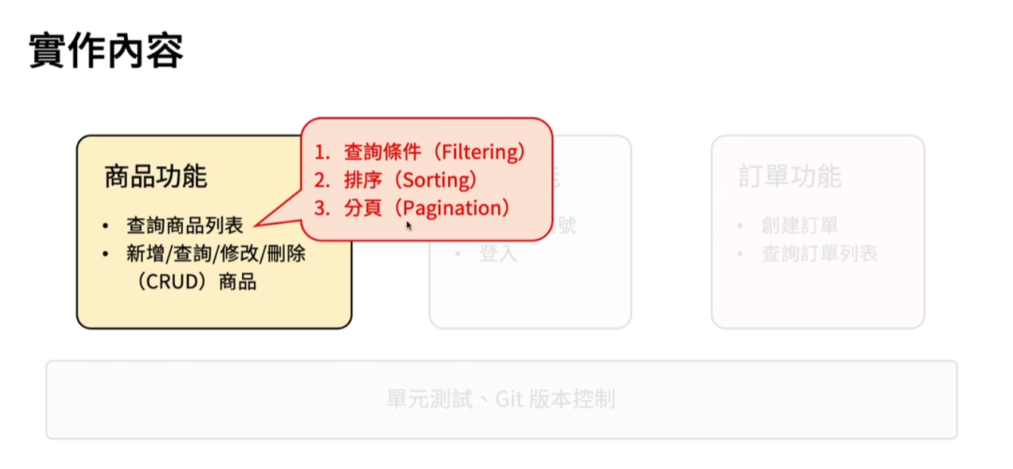

Slide 5
補充內容

Slide 6
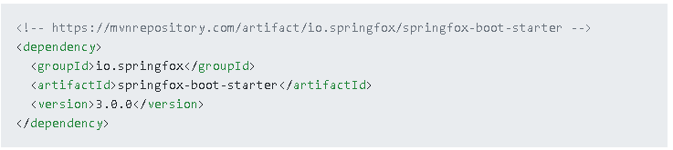
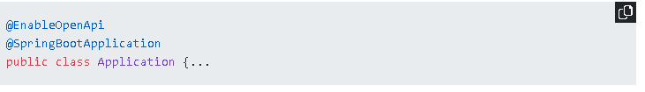
Swagger 3升級指南和新功能體驗！
Swagger 最新版使用
Swagger 最新版的配置步驟和舊版本是一樣，只是每個具體的配置項又略有不同，具體步驟如下。
1.添加依赖
2.開啟Swagger

Slide 7
Swagger 3升級指南和新功能體驗！
3.配置摘要信息
@Configuration @EnableOpenApi public class Swagger2 { @Bean public Docket createRestApi() { return new Docket(DocumentationType.OAS_30) .apiInfo(apiInfo()) .select() .apis(RequestHandlerSelectors.any()) .paths(PathSelectors.any())//paths(PathSelectors.regex("/.*")) .build(); }

Slide 8
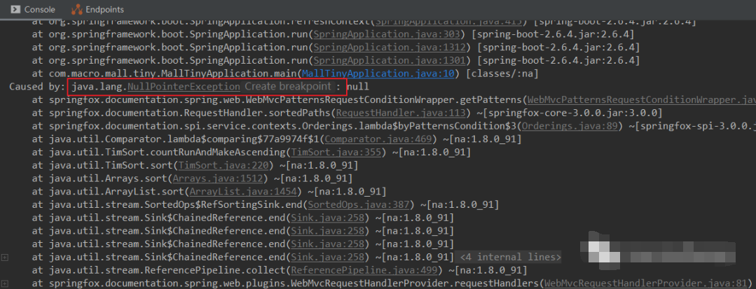
啟動出錯
再次啟動SpringBoot應用後會出現一個空指針異常，一看就是Swagger問題，原來挺好用的Swagger不能用了！

Slide 9
1.在Swagger的配置類中添加如下Bean可以解決該問題；
@Bean public static BeanPostProcessor springfoxHandlerProviderBeanPostProcessor() { return new BeanPostProcessor() { @Override public Object postProcessAfterInitialization(Object bean, String beanName) throws BeansException { if (bean instanceof WebMvcRequestHandlerProvider || bean instanceof WebFluxRequestHandlerProvider) { customizeSpringfoxHandlerMappings(getHandlerMappings(bean)); } return bean; } private <T extends RequestMappingInfoHandlerMapping> void customizeSpringfoxHandlerMappings(List<T> mappings) { List<T> copy = mappings.stream() .filter(mapping -> mapping.getPatternParser() == null) .collect(Collectors.toList()); mappings.clear(); mappings.addAll(copy); } @SuppressWarnings("unchecked") private List<RequestMappingInfoHandlerMapping> getHandlerMappings(Object bean) { try { Field field = ReflectionUtils.findField(bean.getClass(), "handlerMappings"); field.setAccessible(true); return (List<RequestMappingInfoHandlerMapping>) field.get(bean); } catch (IllegalArgumentException | IllegalAccessException e) { throw new IllegalStateException(e); } } }; }

Slide 10
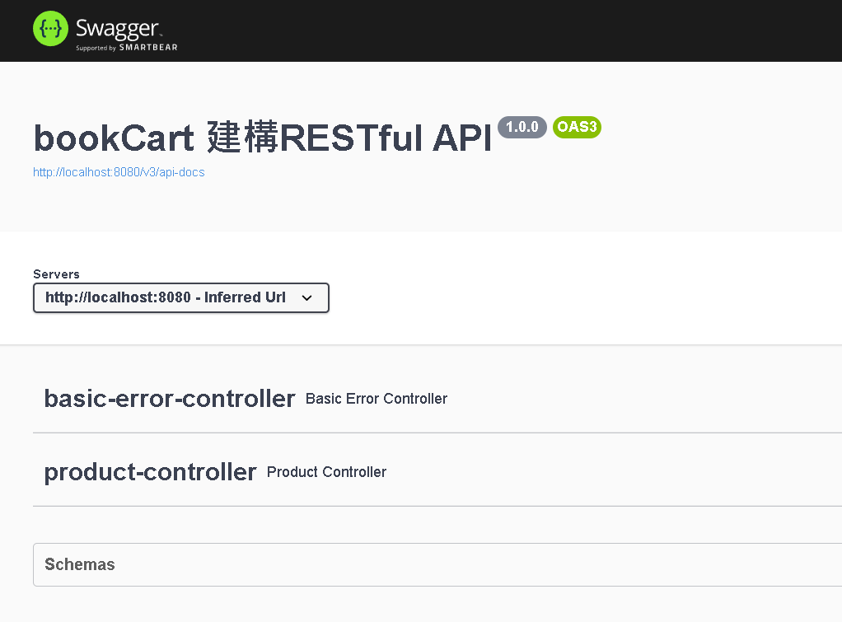
2.修改application. properties檔案，MVC預設的路徑比對政策為PATH_PATTERN_PARSER，需要修改為ANT_PATH_MATCHER；
spring.mvc.pathmatch.matching-strategy=ant-path-matcher

